Slide 1


Turbo: Opportunistic Enhancement for Edge Video Analytics
Yan Lu, Shiqi Jiang, Ting Cao, Yuanchao Shu
SenSys 2022

Slide 2
Outline
Background of edge video analytics
Opportunities for existing VAPs
Idle computing resources
Hard samples
Image (Data) enhancement
Turbo
Detector-specific GAN & Model-aware adversarial training
Resource-aware scheduler
Experiments
Summary

Slide 3
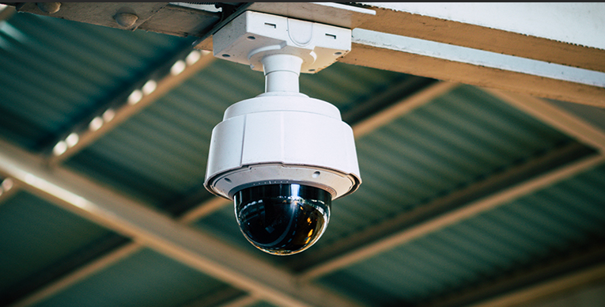
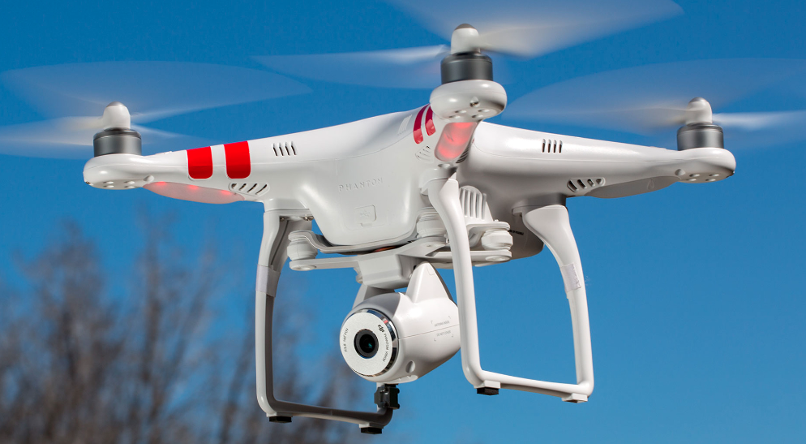
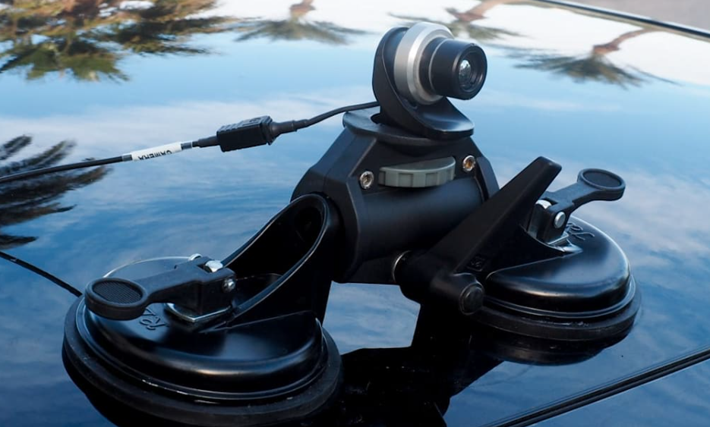
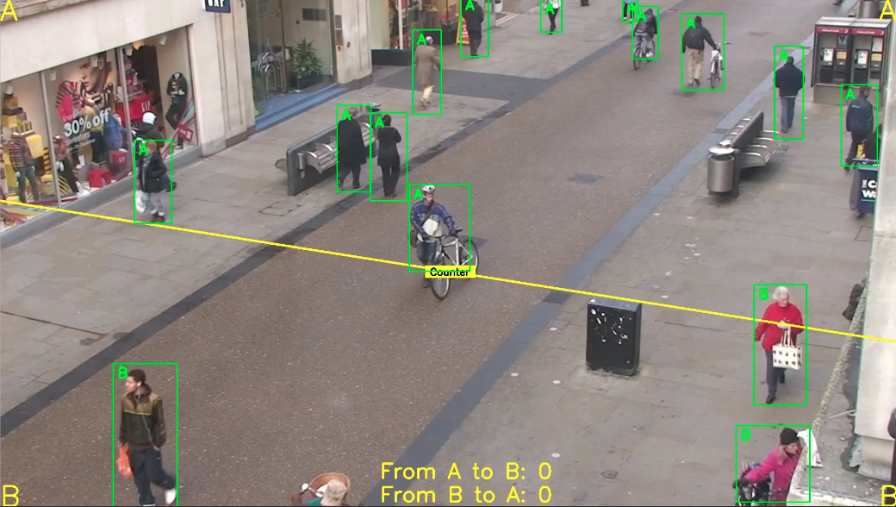
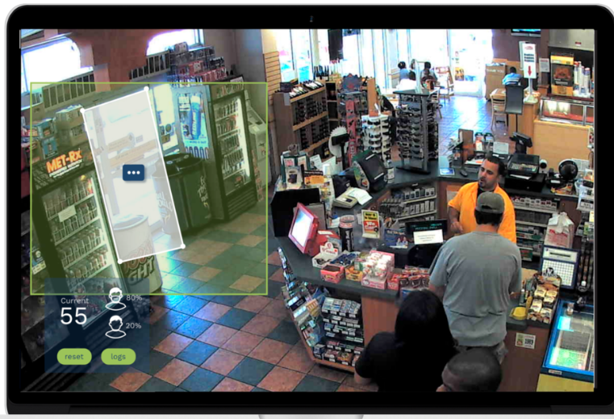
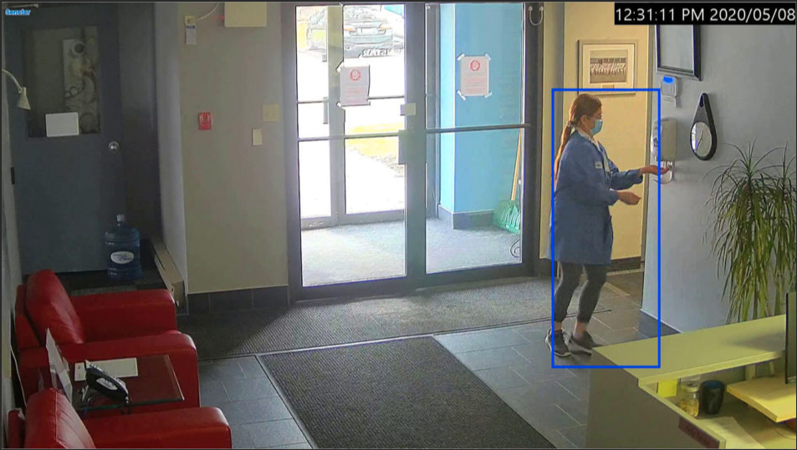
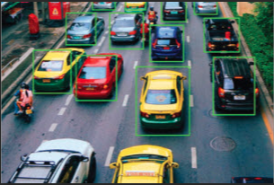
Video is everywhere
Sensors
Video Analytics
Diverse applications

Slide 4

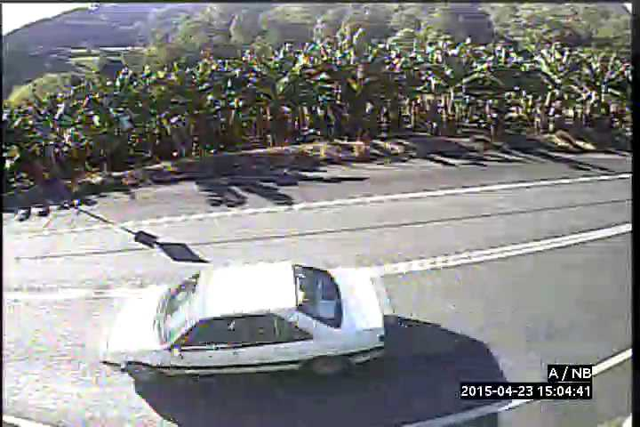
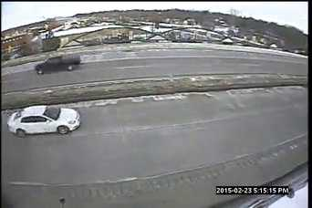
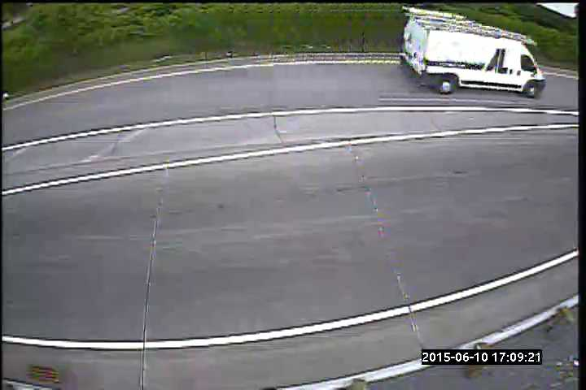


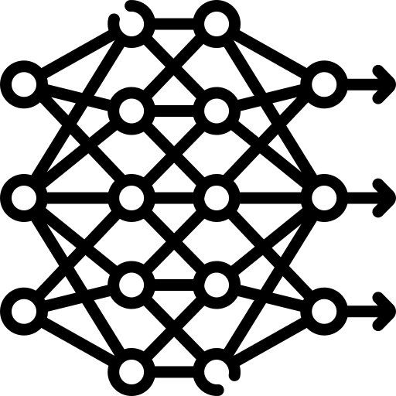
Move to edge
Temporal pruning
Model pruning
Temporal + Model pruning
Privacy
Network
Edge Video Analytics Pipelines
(2015~2020)
GPU
CPU
DNN
CPU
GPU
CPU
How many resources?
Usually, they are set to meet 4 fps instead of 2 or 3 fps!

Slide 5
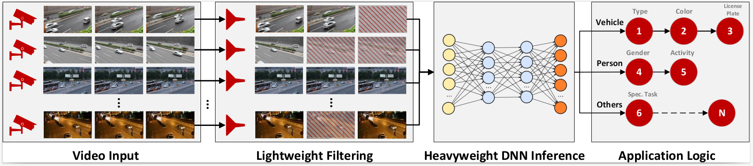
Idle resources are common
Can we leverage these idle resources to improve video analytics?

Slide 6
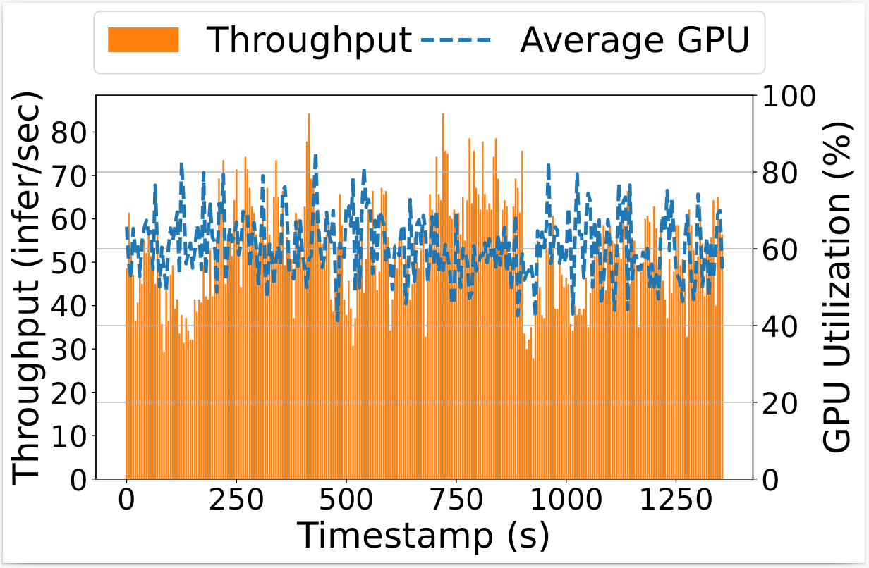
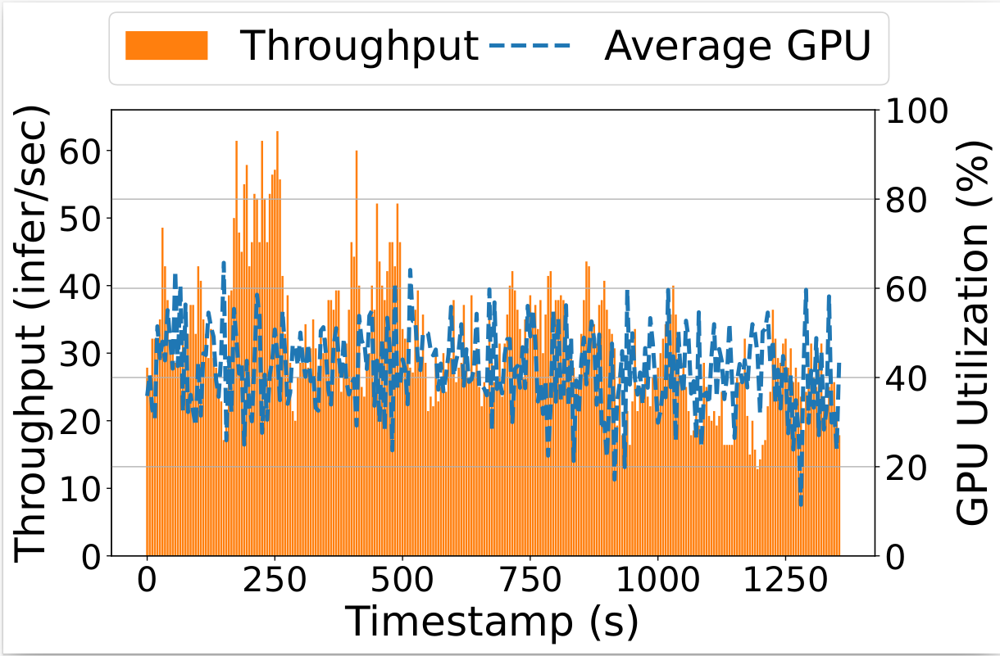
Idle resources are common
Vigil: 19.03% < 45 infer/sec
Glimpse: 7.26% > 50 infer/sec
Vigil
Glimpse
It is hard because they are non-deterministic and fragmented!

Slide 7
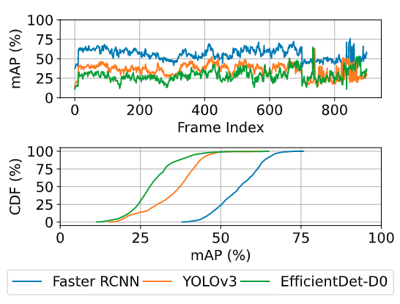

How to leverage idle resources?
A small portion of frames make a bad overall mAP for detectors!
opportunistic
enhancement
hard?
No
Yes
downstream
DNNs
enhancer

Slide 8
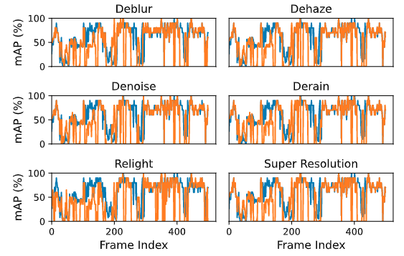
How to improve hard samples?
Off-the-shelf
image enhancement may help?
Why they fail?
Human Visual Perception
≠
Downstream DNNs Accuracy

Slide 9
Key takeaways
Idle computing resources are common but highly dynamic and fragmented.
A small portion of hard frames lead to a bad overall accuracy.
Running off-the-shelf opportunistic enhancement methods is inappropriate.

Slide 10
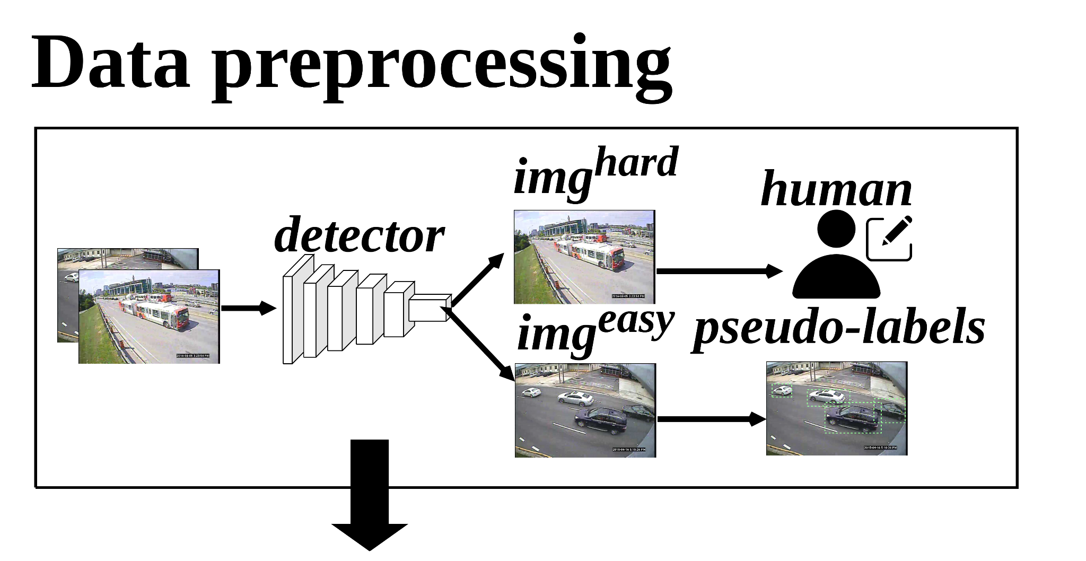
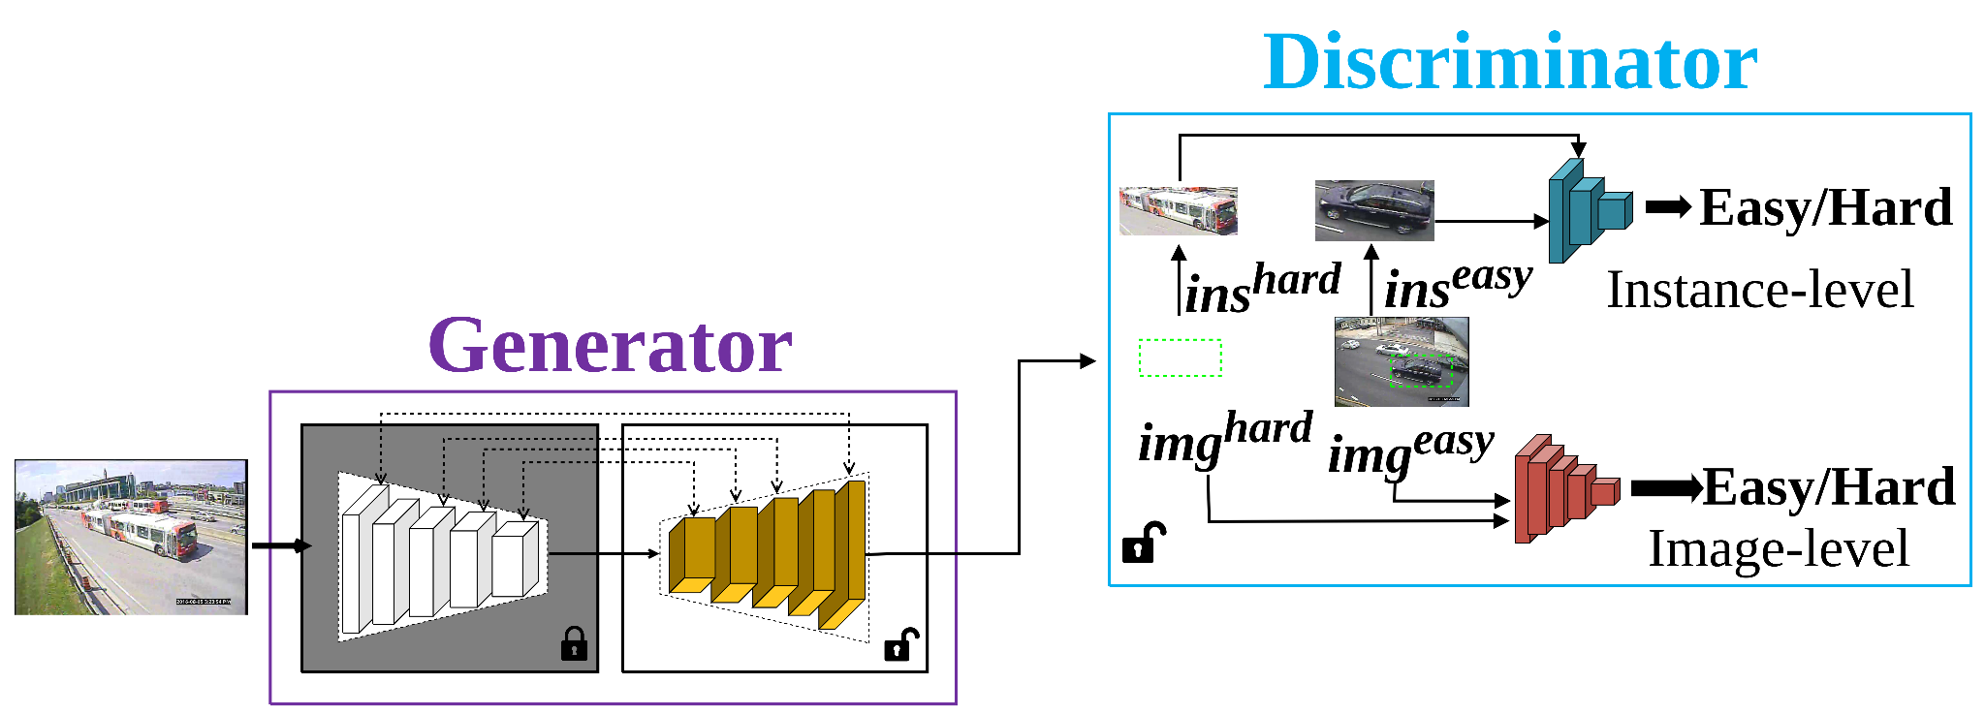
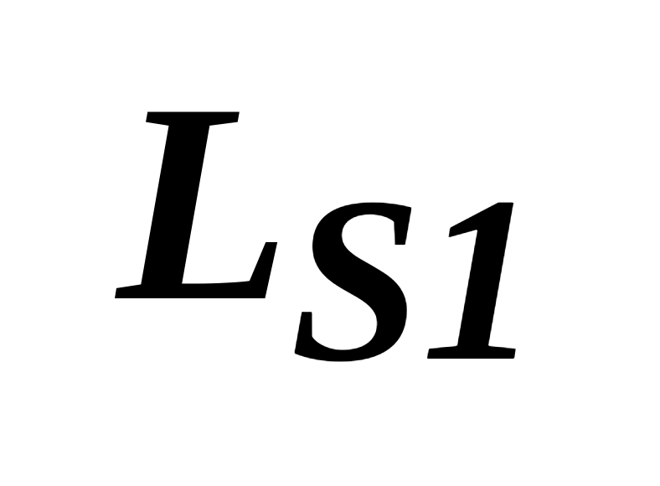
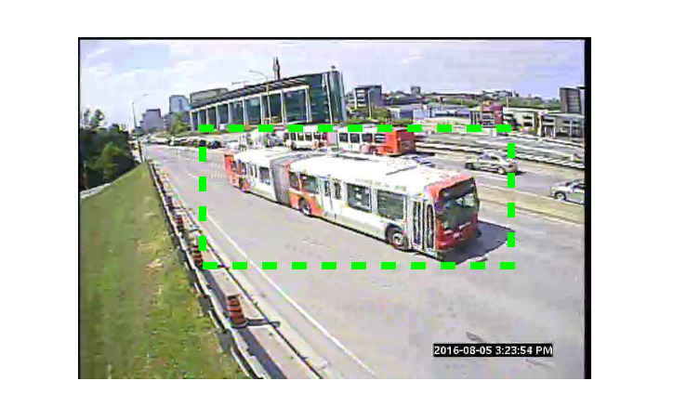
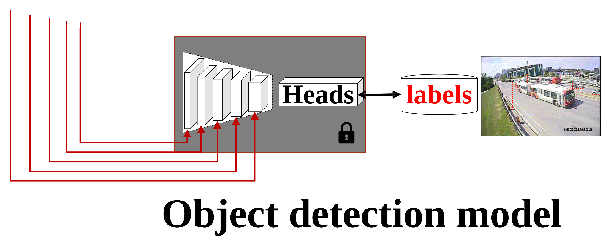
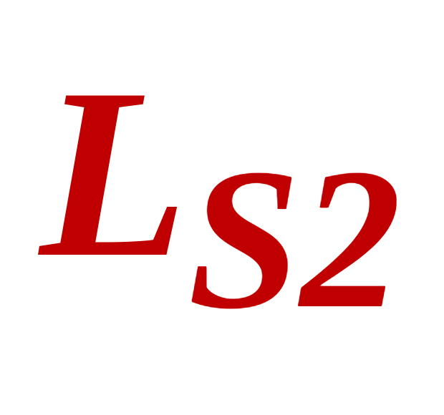
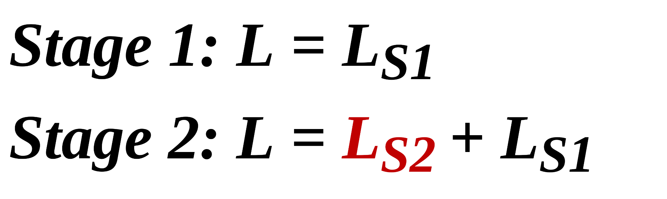
Model-aware Adversarial Training
Stage 0: find easy/hard samples for a downstream detector.
Model-aware easy/hard
Stage 1: learning a G (x) and D (x) for a specific downstream object detection.
Hard -> Generator -> Easy
Stage 2: a multi-exit mechanism
Efficient Generator

Slide 11
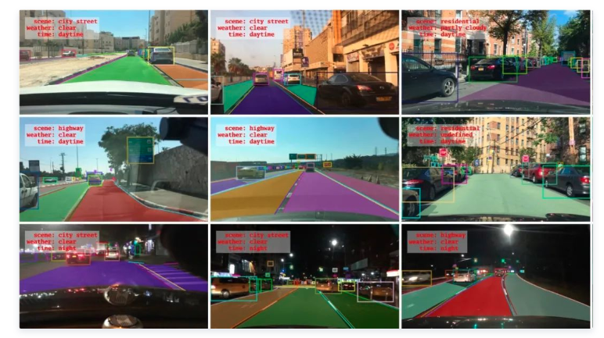
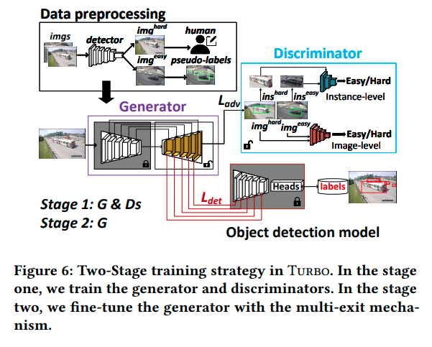
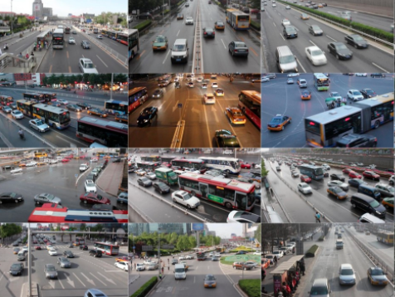
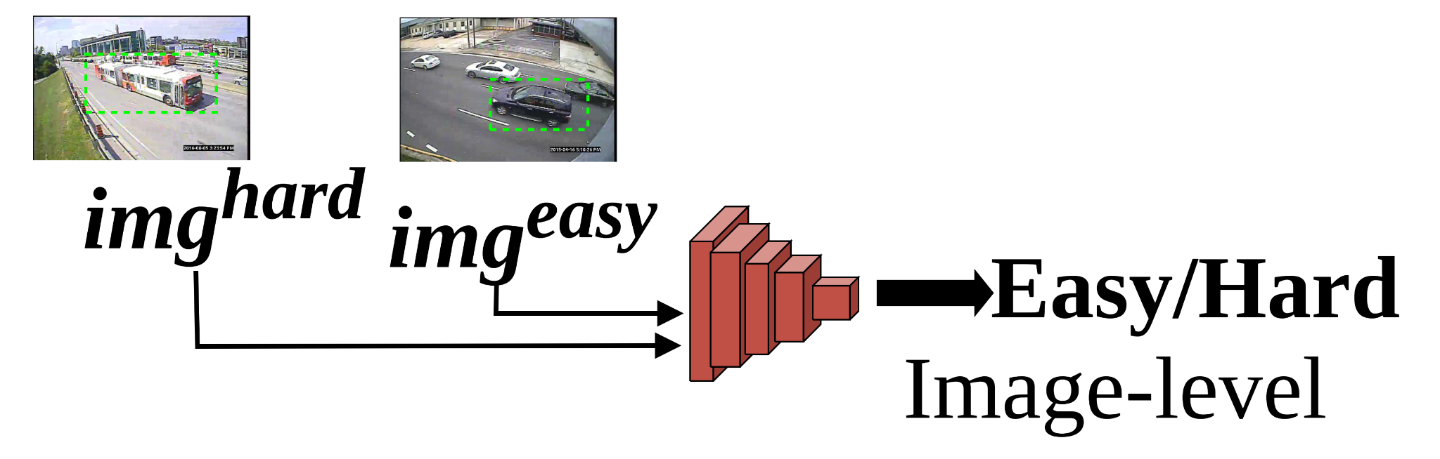
Pre-training and fast adaptation
Pre-training
BDD100K
(100K driving videos)
P(Hard) -> Generator -> P(Easy)
Unsupervised adaptation
x -> Discriminator -> Easy/Hard
Unlabeled target videos

Slide 12
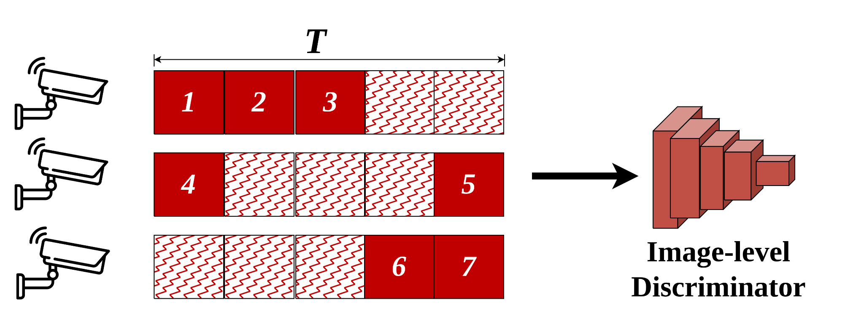
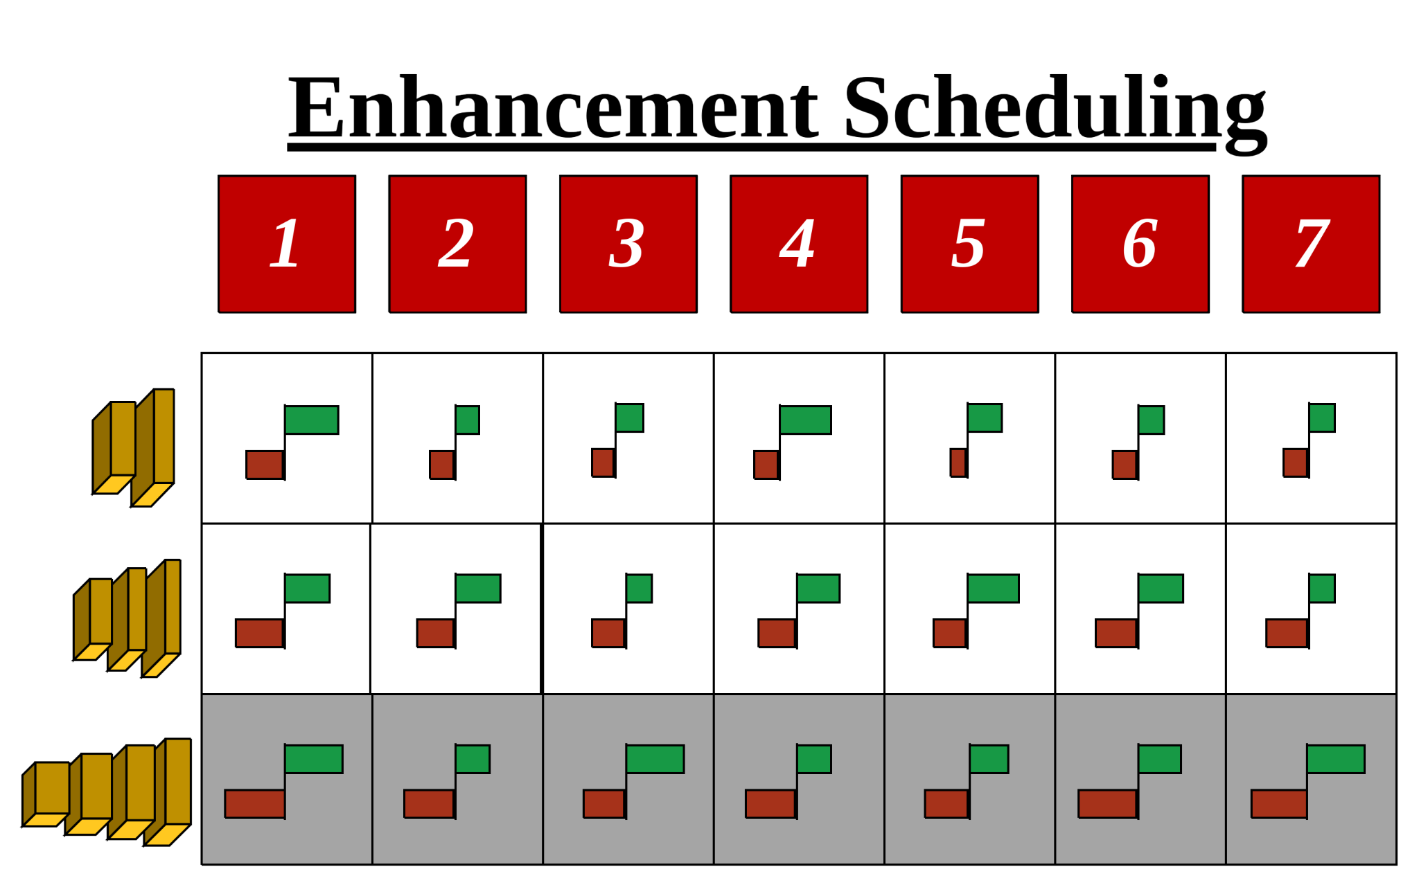
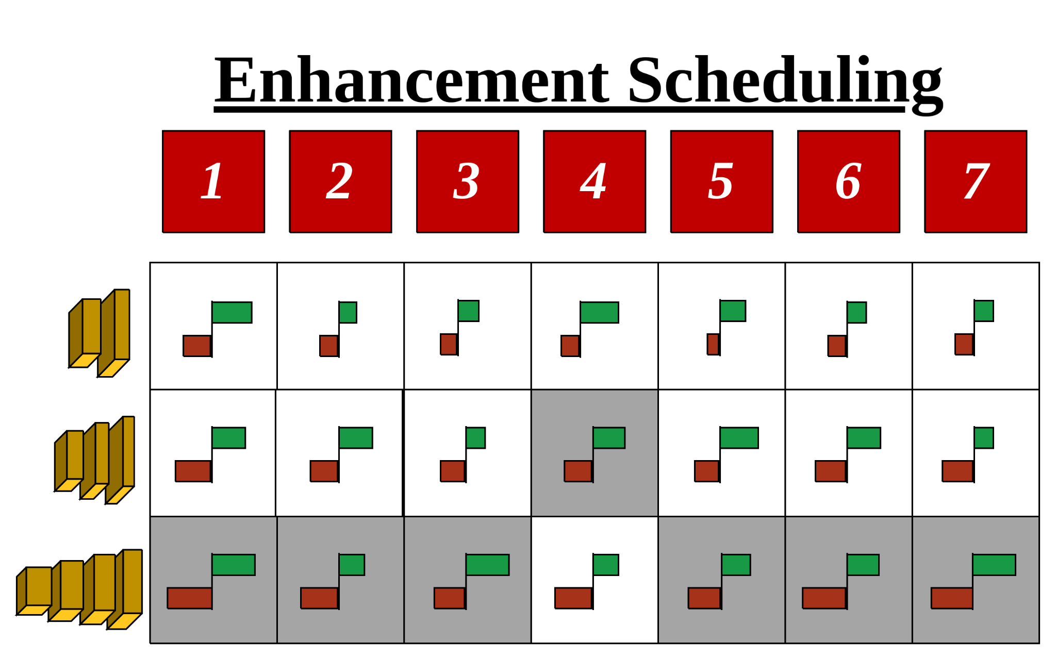
Resource-aware scheduling
All frames are required to be processed within T.
Repeat the last step until the total latency < T
All frames are assigned to the deepest enhancer.
Based on enhancement profiling results, we can select a frame with the minimal marginal accuracy gain and assign it to a weaker enhancer.

Slide 13
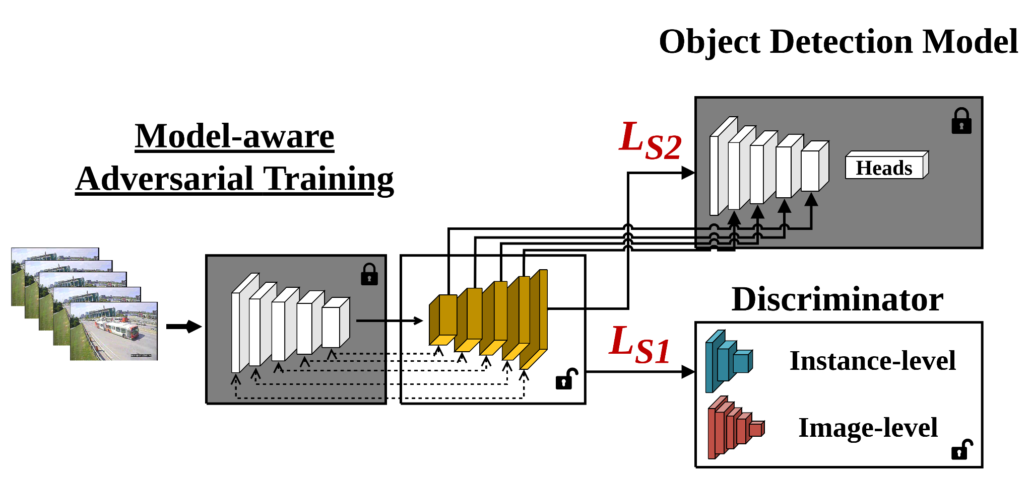

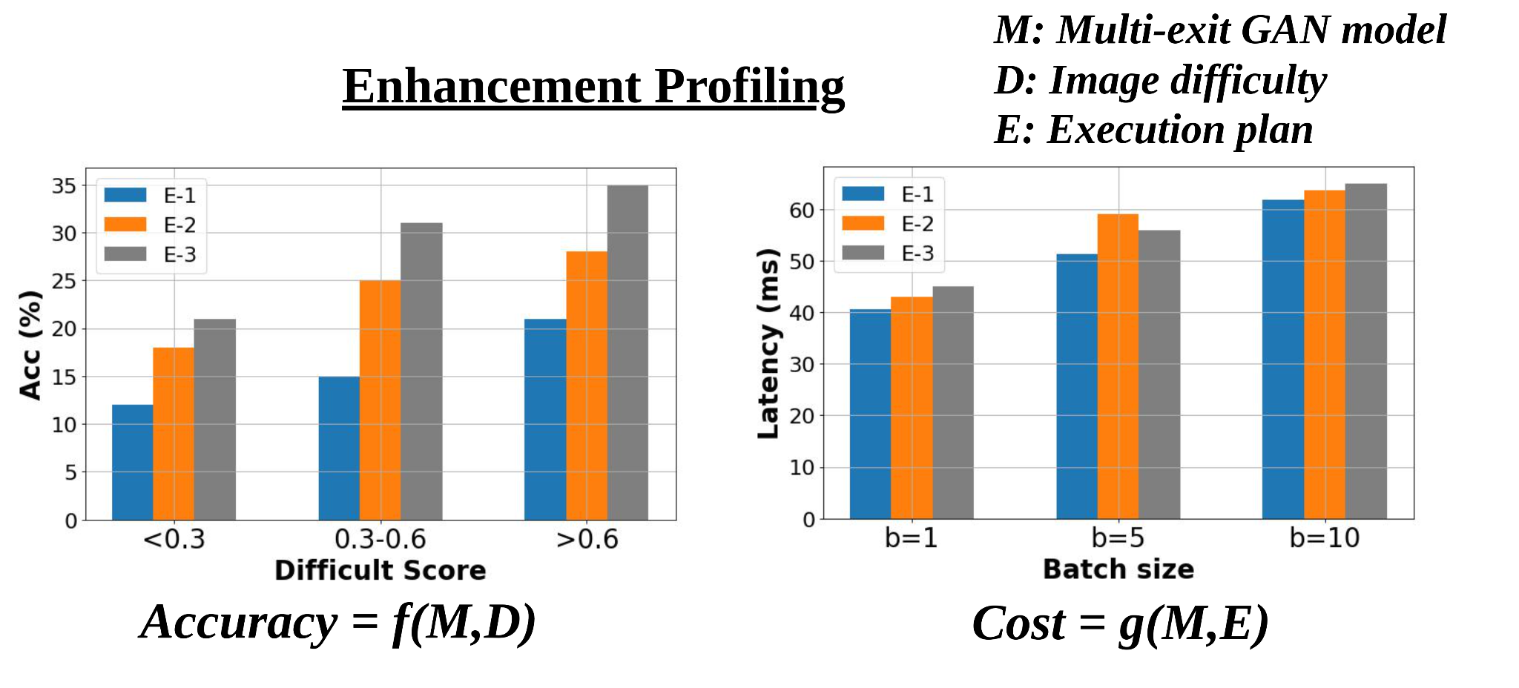
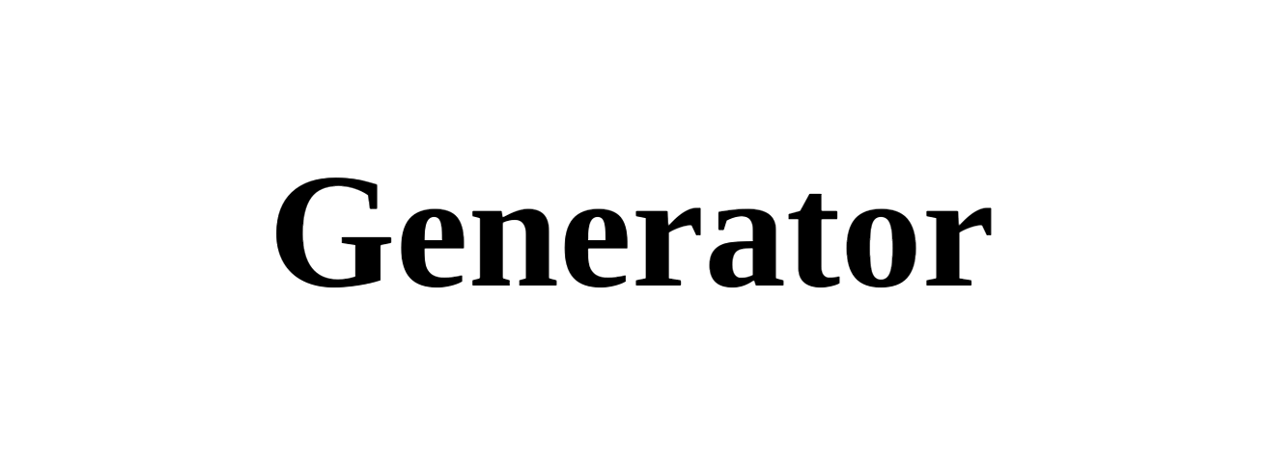

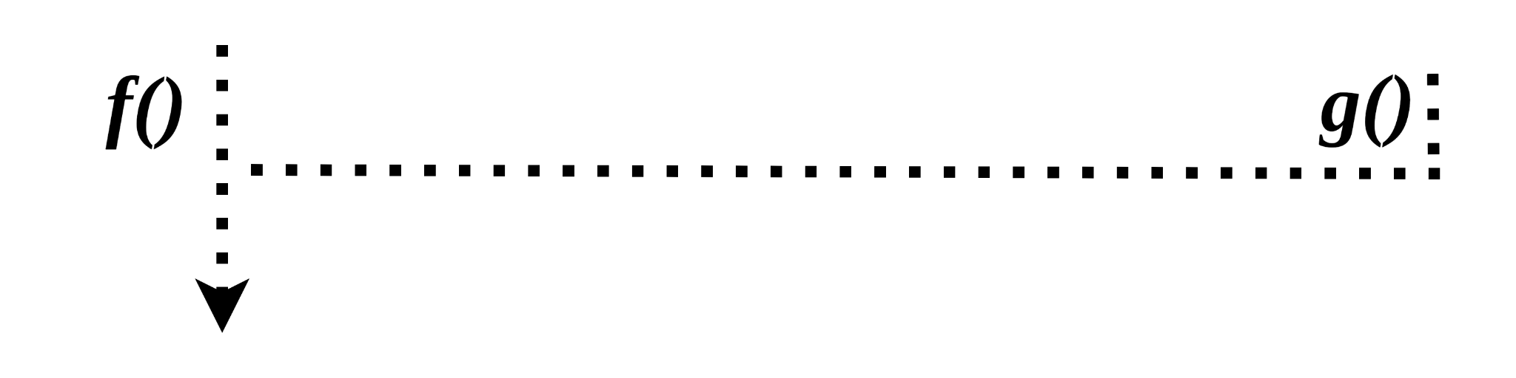

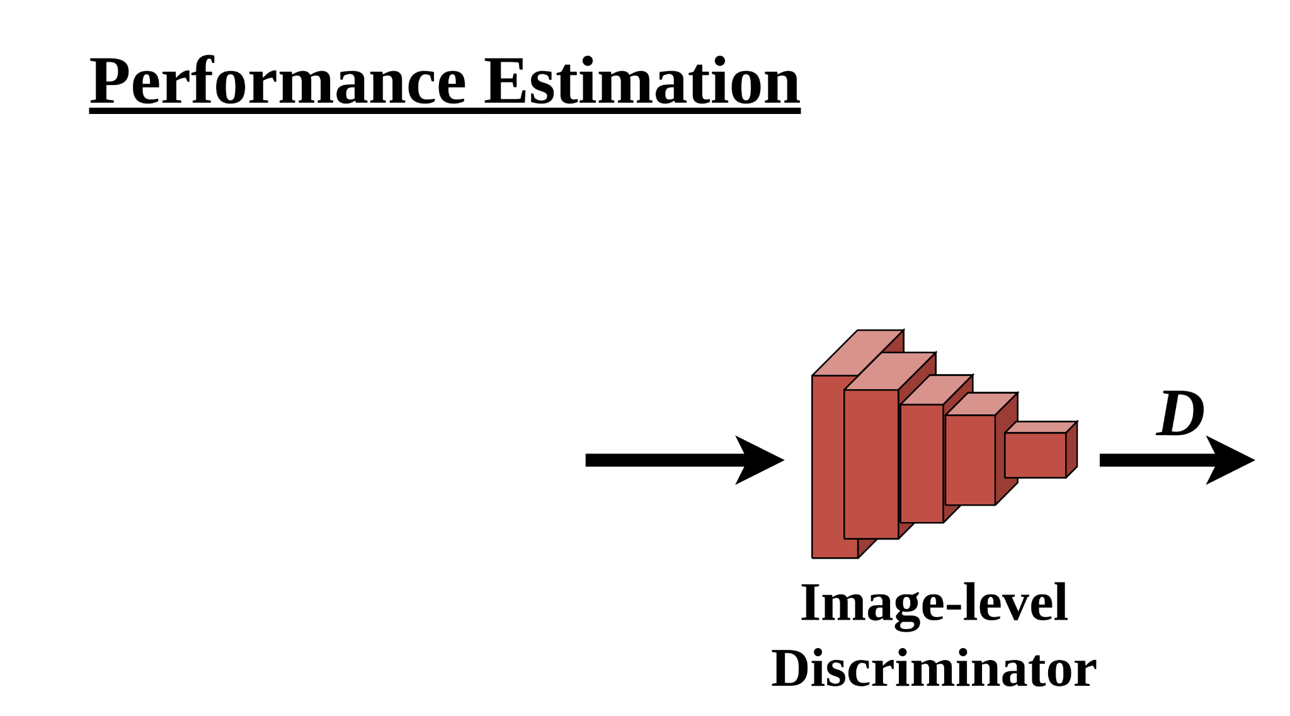
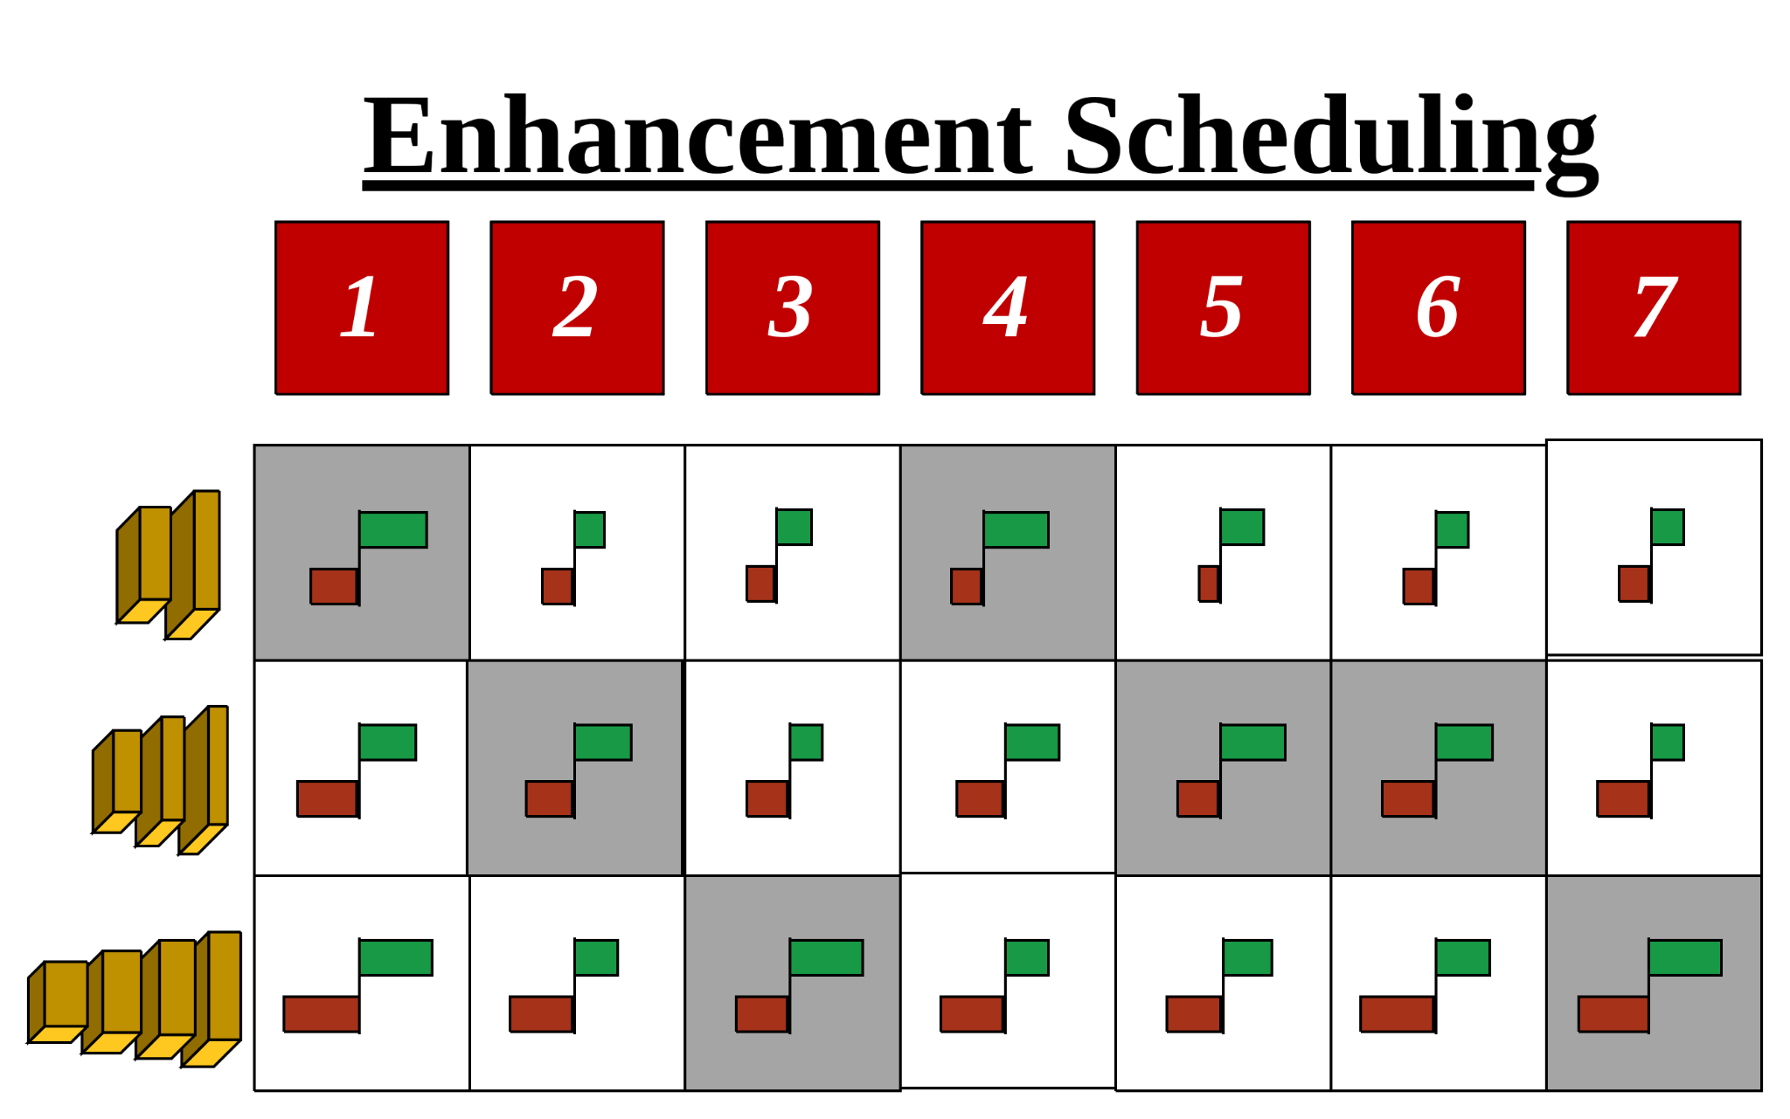
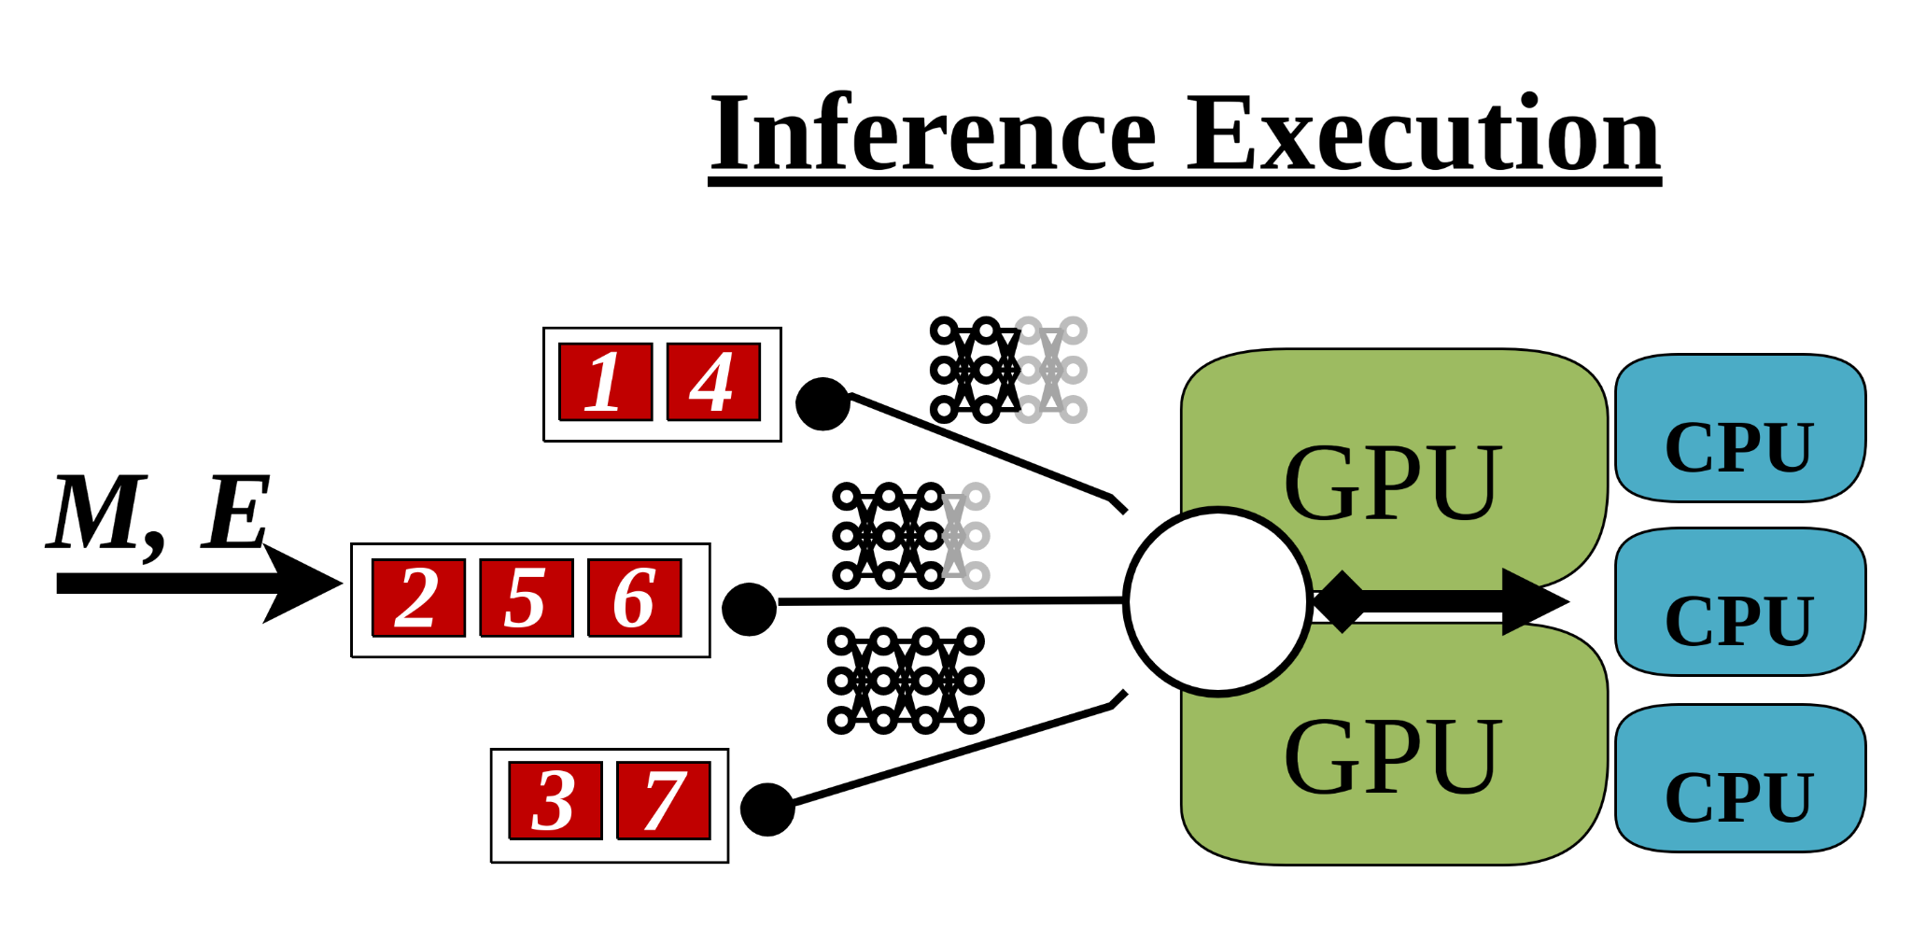
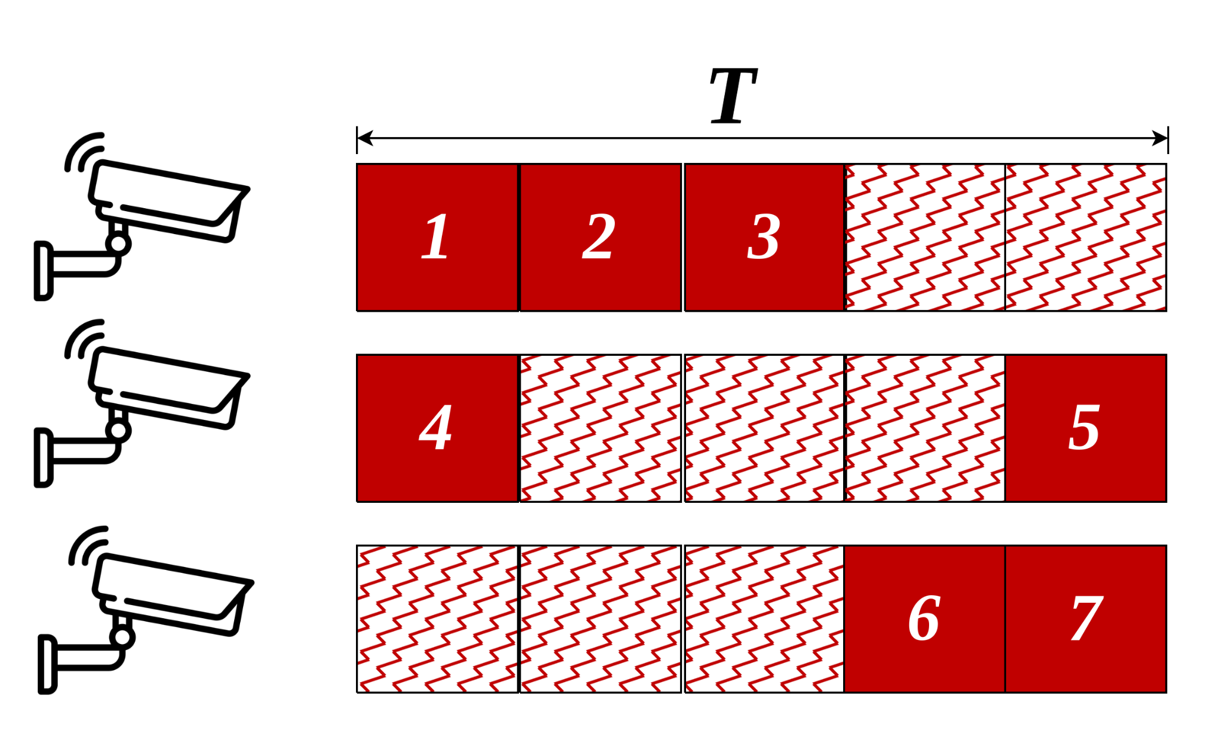
Overview

Slide 14
Experiments
Detectors: YOLOv3, Faster RCNN, EfficientDet-D0.
Test platforms: Nvidia Tesla V100 and Tesla T4.
Testing Dataset: UA-DETRAC and AICity.
Video analytics pipeline:
Glimpse: temporal pruning
Vigil: model pruning
NoScope: temporal pruning + model pruning

Slide 15
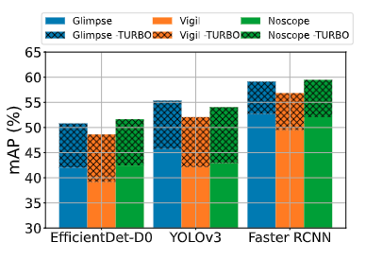
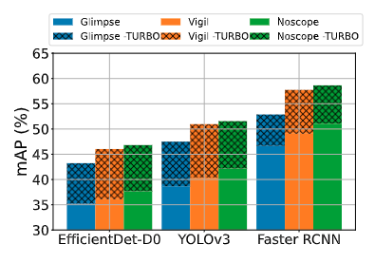
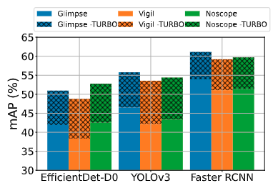
End-to-end results (Accuracy)
UA-DETRAC & T4
AICity & T4
UA-DETRAC & V100
On UA-DETRAC, Turbo achieves 9.35%, 11.34%, 7.27% mAP improvement on average for 3 models.
Usually, we can achieve the maximum mAP improvements on Vigil. It is because model pruning groups most hard frames for Turbo.

Slide 16
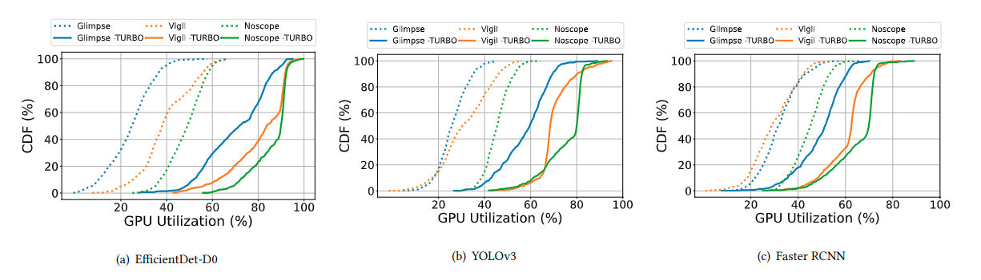
End-to-end results (Idle GPU)
UA-DETRAC & T4

Slide 17




Summary
Even on advanced video analytics pipelines, idle computing resources are common but ignored.
Turbo selectively enhances incoming frames based GPU resource availability via a detector-specific GAN and resource-aware scheduling algorithm.
Turbo achieves 7.27-11.34% mAP improvements by judiciously allocating 15.81-37.67% GPU idle resources.

